Slide 1
A History of Numerical Analysis Ideas
MAHRUKH KHAN
COMPUTER SCIENCE AND ELECTRICAL ENGINEERING
UNIVERSITY OF MISSOURI ,KANSAS CITY

Slide 2
What is Different in Numerical Computing?

Slide 3
What is Different in Numerical Computing?
Well, it’s numbers

Slide 4

Scientific Computing vs.
Numerical Analysis

Slide 5
Is there anything special with numerical computing?

Slide 6
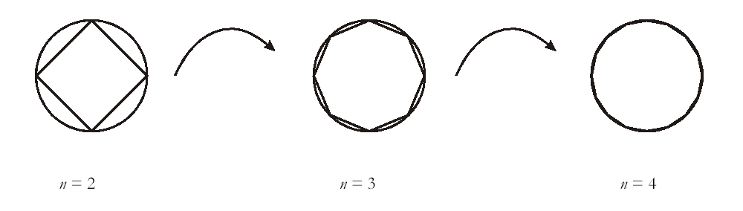
A Small Example
A computation of π

Slide 7
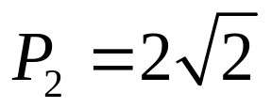

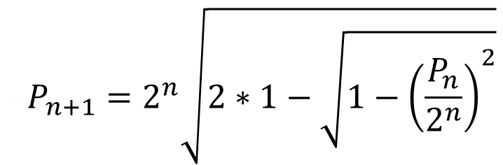
Simple iteration:

Slide 8
2 2.828427124746190
3 3.061467458920719
4 3.121445152258053
5 3.136548490545941
6 3.140331156954739
7 3.141277250932757
8 3.141513801144145
9 3.141572940367883
10 3.141587725279961
11 3.141591421504635
12 3.141592345611077
13 3.141592576545004
14 3.141592633463248
15 3.141592654807589
16 3.141592645321215
17 3.141592607375720
18 3.141592910939673
19 3.141594125195191
20 3.141596553704820
21 3.141596553704820
22 3.141674265021758
23 3.141829681889202
24 3.142451272494134
25 3.142451272494134
26 3.162277660168380
27 3.162277660168380
28 3.464101615137754
29 4.000000000000000
30 0.000000000000000
31 0.000000000000000
Result of 15 digit computation
Red digits are correct
Gray and green digits are incorrect

Slide 9
2 2.828427124746190
3 3.061467458920719
4 3.121445152258053
5 3.136548490545941
6 3.140331156954739
7 3.141277250932757
8 3.141513801144145
9 3.141572940367883
10 3.141587725279961
11 3.141591421504635
12 3.141592345611077
13 3.141592576545004
14 3.141592633463248
15 3.141592654807589
16 3.141592645321215
17 3.141592607375720
18 3.141592910939673
19 3.141594125195191
20 3.141596553704820
21 3.141596553704820
22 3.141674265021758
23 3.141829681889202
24 3.142451272494134
25 3.142451272494134
26 3.162277660168380
27 3.162277660168380
28 3.464101615137754
29 4.000000000000000
30 0.000000000000000
31 0.000000000000000
. . .
Result of 15 digit computation
Red digits are correct
Gray and green digits are incorrect
π = 0 ?

Slide 10
Where’s the problem?

Slide 11
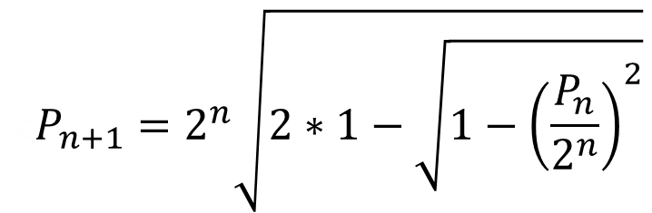
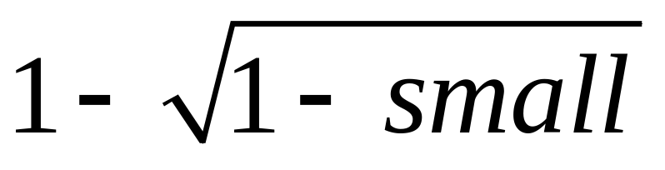
Where’s the problem?
is calculated as zero

Slide 12
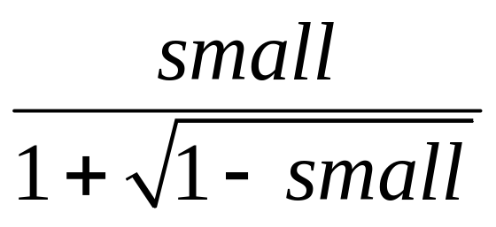
Let’s replace
with the algebraically identical expression

Slide 13
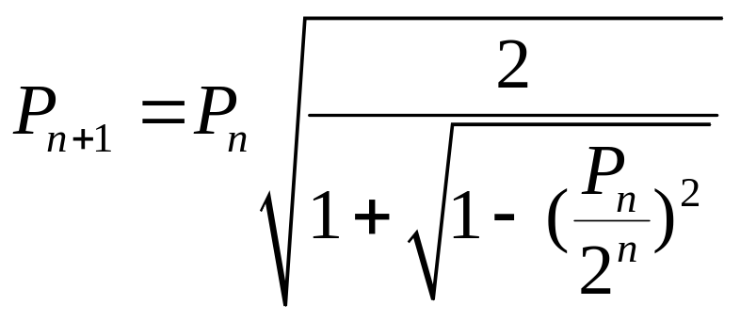
New iteration:
results in …

Slide 14
2 2.828427124746190
3 3.061467458920719
4 3.121445152258053
5 3.136548490545941
6 3.140331156954739
7 3.141277250932757
8 3.141513801144145
9 3.141572940367883
10 3.141587725279961
11 3.141591421504635
12 3.141592345611077
13 3.141592576545004
14 3.141592633463248
15 3.141592654807589
16 3.141592645321215
17 3.141592607375720
18 3.141592910939673
19 3.141594125195191
20 3.141596553704820
21 3.141596553704820
22 3.141674265021758
23 3.141829681889202
24 3.142451272494134
25 3.142451272494134
26 3.162277660168380
27 3.162277660168380
28 3.464101615137754
29 4.000000000000000
30 0.000000000000000
31 0.000000000000000
2 2.828427124746190
3 3.061467458920719
4 3.121445152258053
5 3.136548490545940
6 3.140331156954753
7 3.141277250932773
8 3.141513801144301
9 3.141572940367091
10 3.141587725277160
11 3.141591421511200
12 3.141592345570118
13 3.141592576584872
14 3.141592634338563
15 3.141592648776985
16 3.141592652386591
17 3.141592653288992
18 3.141592653514593
19 3.141592653570993
20 3.141592653585093
21 3.141592653588618
22 3.141592653589499
23 3.141592653589719
24 3.141592653589774
25 3.141592653589788
26 3.141592653589792
27 3.141592653589793
28 3.141592653589793
29 3.141592653589793
30 3.141592653589793
31 3.141592653589793
π correct to all digits

Slide 15
Boring…
Is that all there is
to numerical analysis?

Slide 16
Not so boring if the result of this computation affects

Slide 17
Not so boring if the result of this computation affects
The ability of the next plane you fly to stay in the air

Slide 18
Not so boring if the result of this computation affects
The ability of the next plane you fly to stay in the air
The integrity of the next bridge you cross

Slide 19
Not so boring if the result of this computation affects
The ability of the next plane you fly to stay in the air
The integrity of the next bridge you cross
The state of the economy on which you live

Slide 20
Not so boring if the result of this computation affects
The ability of the next plane you fly to stay in the air
The integrity of the next bridge you cross
The state of the economy on which you live
The path of a missile that isn’t intended to strike you

Slide 21
So what are the common problems of numerical analysis?

Slide 22
So what are the common problems of numerical analysis?
Application areas:

Slide 23
So what are the common problems of numerical analysis?
Application areas:
Petroleum modeling

Slide 24
So what are the common problems of numerical analysis?
Application areas:
Petroleum modeling
Atomic energy – including weapons

Slide 25
So what are the common problems of numerical analysis?
Application areas:
Petroleum modeling
Atomic energy – including weapons
Weather modeling

Slide 26
So what are the common problems of numerical analysis?
Application areas:
Petroleum modeling
Atomic energy – including weapons
Weather modeling
Other modeling such as aircraft and automobile

Slide 27
So what are the common problems of numerical analysis?
Algorithm areas:

Slide 28
So what are the common problems of numerical analysis?
Algorithm areas:
Linear Equations

Slide 29
So what are the common problems of numerical analysis?
Algorithm areas:
Linear Equations
Nonlinear equations - single and systems

Slide 30
So what are the common problems of numerical analysis?
Algorithm areas:
Linear Equations
Nonlinear equations - single and systems
Optimization

Slide 31
So what are the common problems of numerical analysis?
Algorithm areas:
Linear Equations
Nonlinear equations - single and systems
Optimization
Data Fitting - interpolation and approximation

Slide 32
So what are the common problems of numerical analysis?
Algorithm areas:
Linear Equations
Nonlinear equations - single and systems
Optimization
Data Fitting - interpolation and approximation
Integration

Slide 33
So what are the common problems of numerical analysis?
Algorithm areas:
Linear Equations
Nonlinear equations - single and systems
Optimization
Data Fitting - interpolation and approximation
Integration
Differential Equations - ordinary and partial

Slide 34
Didn’t we study that stuff in math classes?

Slide 35
Didn’t we study that stuff in math classes?
Yes, but as the Pi Example shows, math classes are just the beginning

Slide 36
Let’s get back to history

Slide 37
Why were computers used primarily for numerical problems initially?

Slide 38
Why were computers used primarily for numerical problems initially?
Mathematicians and engineers designed them

Slide 39
Why were computers used primarily for numerical problems initially?
Mathematicians and engineers designed them
A history of algorithms in that area

Slide 40
Why were computers used primarily for numerical problems initially?
Mathematicians and engineers designed them
A history of algorithms in that area
Immediate war-time and post-war-time applications

Slide 41
Why were computers used primarily for numerical problems initially?
Mathematicians and engineers designed them
A history of algorithms in that area
Immediate war-time and post-war-time applications
Applications did not depend upon having a large number of computers

Slide 42
What were the major computing ideas that arose in numerical analysis?

Slide 43
What were the major computing ideas that arose in numerical analysis?
Backward error analysis

Slide 44
What were the major computing ideas that arose in numerical analysis?
Backward error analysis
input
output

Slide 45
What were the major computing ideas that arose in numerical analysis?
Backward error analysis
true operation
input
output

Slide 46
What were the major computing ideas that arose in numerical analysis?
Backward error analysis
true operation
approximate operation
input
output

Slide 47
What were the major computing ideas that arose in numerical analysis?
Backward error analysis
true operation
error
approximate operation
input
output

Slide 48
What were the major computing ideas that arose in numerical analysis?
Backward error analysis
true operation
approximate operation
input
output

Slide 49
What were the major computing ideas that arose in numerical analysis?
Backward error analysis
true operation
backward
error
approximate operation
input
output

Slide 50
What were the major computing ideas that arose in numerical analysis?
Backward error analysis
FORTRAN

Slide 51
What were the major computing ideas that arose in numerical analysis?
Backward error analysis
FORTRAN
Mathematical based
Computationally Efficient
Portable
Standardized – 3 times

Slide 52
What were the major computing ideas that arose in numerical analysis?
Backward error analysis
FORTRAN
Mathematical software packages

Slide 53
What were the major computing ideas that arose in numerical analysis?
Backward error analysis
FORTRAN
Mathematical software packages
Matlab, Mathematica
Scientific computing environments

Slide 54
What were the major computing ideas that arose in numerical analysis?
Backward error analysis
FORTRAN
Mathematical software packages
Matlab, Mathematica
Super computers - Parallelism

Slide 55
Mathematical Preliminaries
and Error Analysis

Slide 56
Why measure errors?
1) To determine the accuracy of numerical results.
2) To develop stopping criteria for iterative algorithms.

Slide 57
True Error
Defined as the difference between the true value in a calculation and the approximate value found using a numerical method etc.
True Error = True Value – Approximate Value

Slide 58


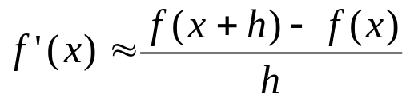



Example—True Error
The derivative,
of a function
can be
approximated by the equation,
If
and
a) Find the approximate value of
b) True value of
c) True error for part (a)

Slide 59


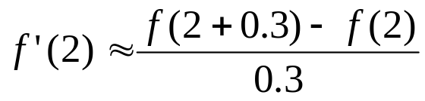
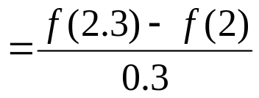
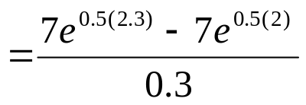
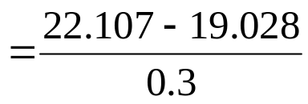

Example (cont.)
Solution:
a) For
and

Slide 60








Example (cont.)
Solution:
b) The exact value of
can be found by using
our knowledge of differential calculus.
So the true value of
is
True error is calculated as
True Value – Approximate Value

Slide 61

Relative True Error
Defined as the ratio between the true error, and the true value.
True Error
Relative True Error (
) =
True Value

Slide 62


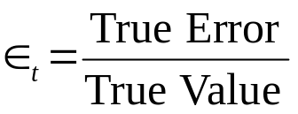
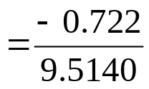



Example—Relative True Error
Following from the previous example for true error,
find the relative true error for
at
with
From the previous example,
Relative True Error is defined as
as a percentage,

Slide 63

Approximate Error
What can be done if true values are not known or are very difficult to obtain?
Approximate error is defined as the difference between the present approximation and the previous approximation.
Approximate Error (
) = Present Approximation – Previous Approximation

Slide 64



Example—Approximate Error
For
at
find the following,
a)
using
b)
using
c) approximate error for the value of
for part b)
Solution:
a) For
and

Slide 65
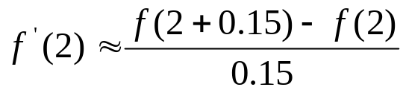
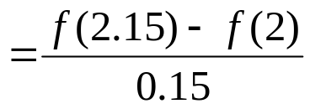
Example (cont.)
Solution: (cont.)
b) For
and

Slide 66
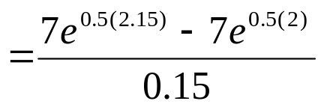
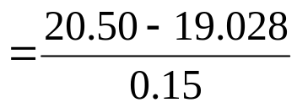




Example (cont.)
Solution: (cont.)
c) So the approximate error,
is
Present Approximation – Previous Approximation

Slide 67

Relative Approximate Error
Defined as the ratio between the approximate error and the present approximation.
Approximate Error
Relative Approximate Error (
) =
Present Approximation

Slide 68



Example—Relative Approximate Error
For
at
, find the relative approximate
error using values from
and
Solution:
From Example 3, the approximate value of
using
and
using
Present Approximation – Previous Approximation

Slide 69

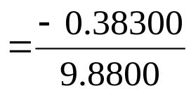



Example (cont.)
Solution: (cont.)
Approximate Error
Present Approximation
as a percentage,
Absolute relative approximate errors may also need to be calculated,

Slide 70



How is Absolute Relative Error used as a stopping criterion?
If
where
is a pre-specified tolerance, then
no further iterations are necessary and the process is stopped.
If at least m significant digits are required to be correct in the final answer, then

Slide 71



Table of Values
For
at
with varying step size,
0.3 | 10.263 | N/A | 0
0.15 | 9.8800 | 3.877% | 1
0.10 | 9.7558 | 1.273% | 1
0.01 | 9.5378 | 2.285% | 1
0.001 | 9.5164 | 0.2249% | 2

Slide 72
SOURCES OF ERROR

Slide 73
Two sources of numerical error
Round off error
Truncation error

Slide 74
Round-off Error

Slide 75
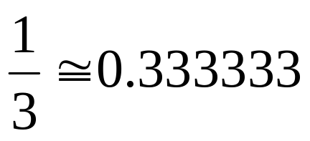
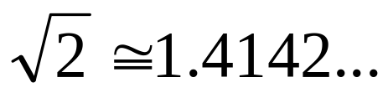
Round off Error
Caused by representing a number approximately

Slide 76
Problems created by round off error
28 people were killed on February 25, 1991 by a missile.
The patriot defense system failed to track and intercept it. Why?

Slide 77

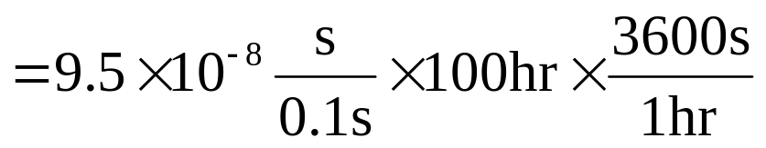

Problem with Patriot missile
Clock cycle of 1/10 seconds was represented in 24-bit fixed point register created an error of 9.5 x 10⁻⁸ seconds.
The battery was on for 100 consecutive hours, thus causing an inaccuracy of

Slide 78
Problem (cont.)
The shift calculated in the ranging system of the missile was 687 meters.
The target was considered to be out of range at a distance greater than 137 meters.

Slide 79
Truncation Error

Slide 80
Truncation error
Error caused by truncating or approximating a mathematical procedure.

Slide 81

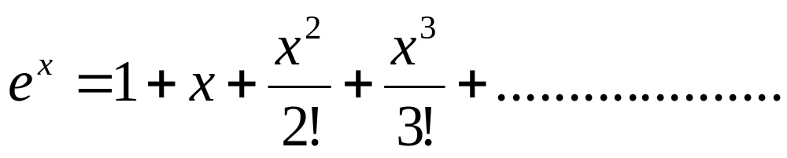
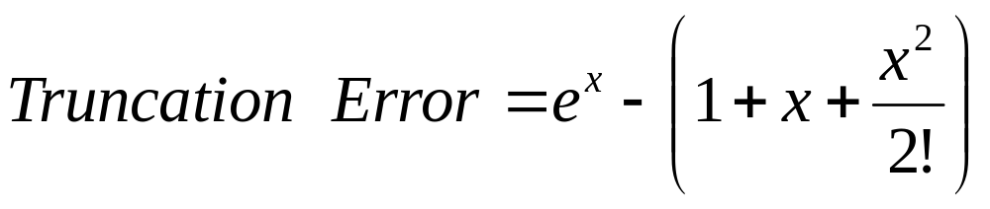
Example of Truncation Error
Taking only a few terms of a Maclaurin series to
approximate
If only 3 terms are used,

Slide 82

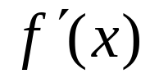
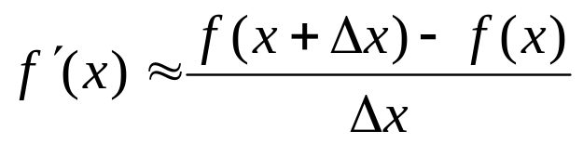
Another Example of Truncation Error
Using a finite
to approximate
secant line
P
tangent line
Q
Figure 1. Approximate derivative using finite Δx

Slide 83
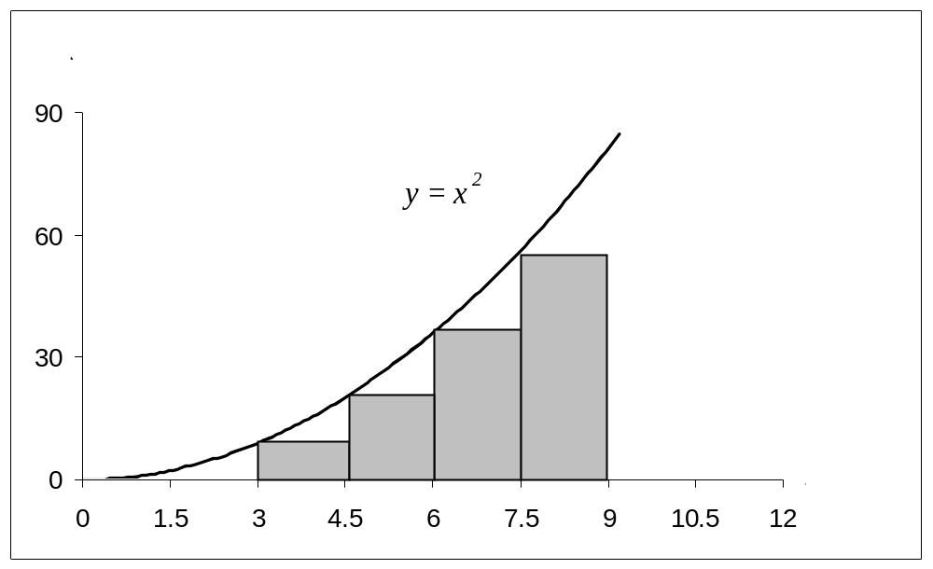
Another Example of Truncation Error
Using finite rectangles to approximate an integral.

Slide 84
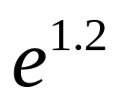
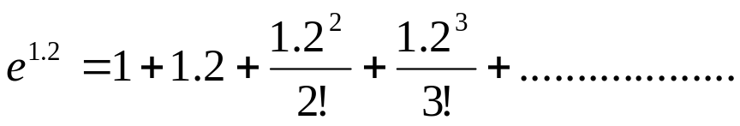

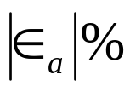
Example 1 —Maclaurin series
Calculate the value of
with an absolute
relative approximate error of less than 1%.
n
1 | 1 | __ | ___
2 | 2.2 | 1.2 | 54.545
3 | 2.92 | 0.72 | 24.658
4 | 3.208 | 0.288 | 8.9776
5 | 3.2944 | 0.0864 | 2.6226
6 | 3.3151 | 0.020736 | 0.62550
6 terms are required. How many are required to get at least 1 significant digit correct in your answer?

Slide 85



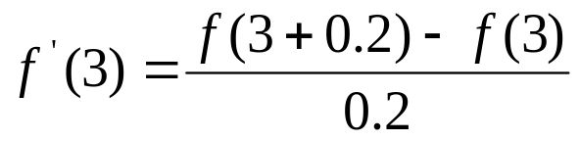
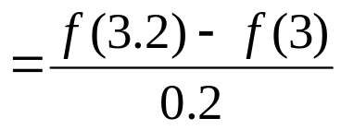
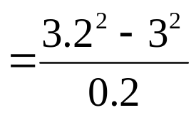
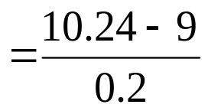
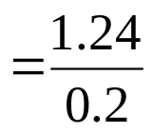





Example 2 —Differentiation
Find
for
using
and
The actual value is
Truncation error is then,
Can you find the truncation error with

Slide 86

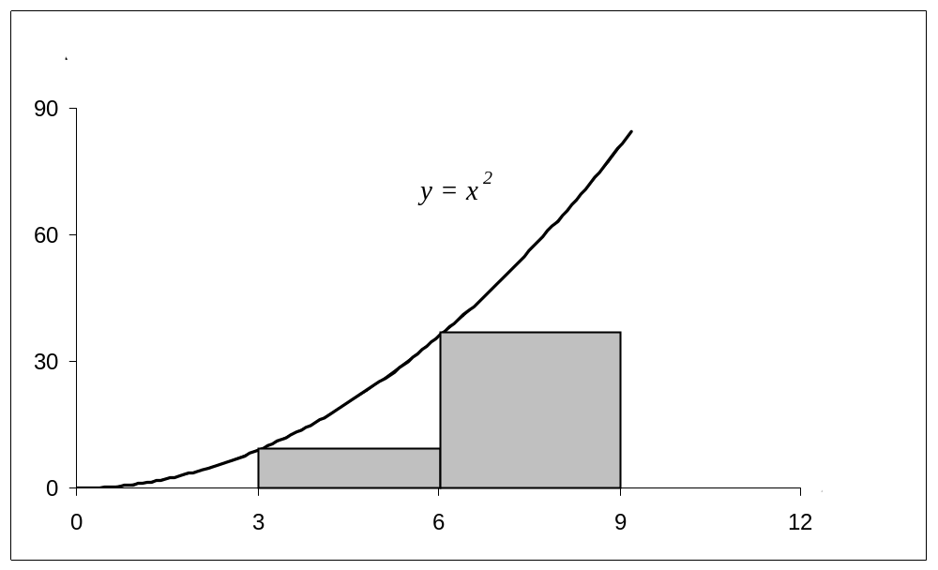
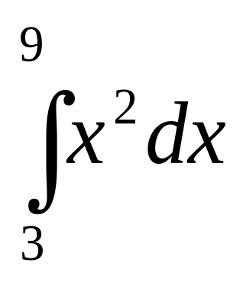
Example 3 — Integration
Use two rectangles of equal width to approximate the area under the curve for
over the interval

Slide 87
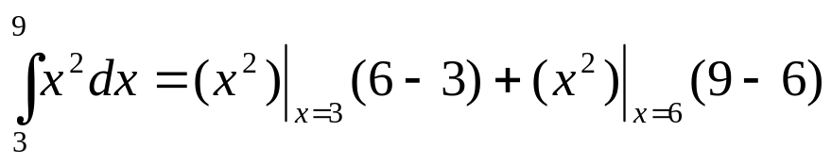


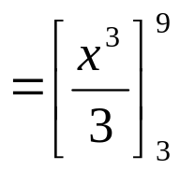
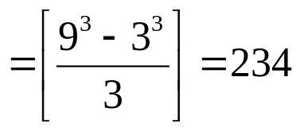

Integration example (cont.)
Choosing a width of 3, we have
Actual value is given by
Truncation error is then
Can you find the truncation error with 4 rectangles?

Slide 88
Binary Representation

Slide 89
How a Decimal Number is Represented

Slide 90
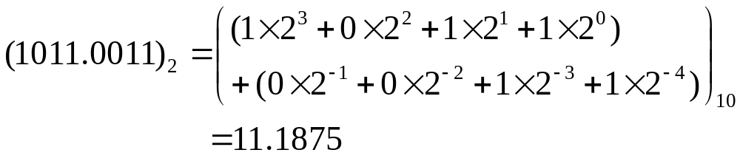
Base 2

Slide 91




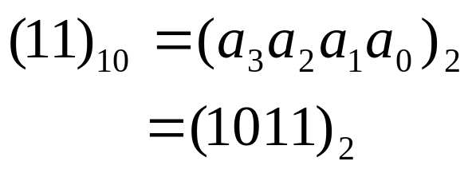
Convert Base 10 Integer to binary representation
Table 1 Converting a base-10 integer to binary representation.
 | Quotient | Remainder
11/2 | 5
5/2 | 2
2/2 | 1
1/2 | 0
Hence

Slide 92
Start
Input (N)₁₀
Integer N to be converted to binary format
i = 0
Divide N by 2 to get quotient Q & remainder R
i=i+1,N=Q
a_{i} = R
No
Is Q = 0?
Yes
n = i
(N)₁₀ = (a_{n}. . .a₀)₂
STOP

Slide 93








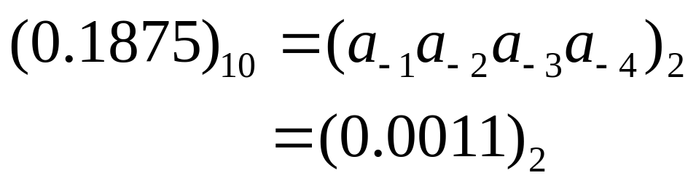
Fractional Decimal Number to Binary
Table 2. Converting a base-10 fraction to binary representation.
 | Number | Number after decimal | Number before decimal
 | 0.375 | 0.375
 | 0.75 | 0.75
 | 1.5 | 0.5
 | 1.0 | 0.0
Hence
Notes:
THG picture

Slide 94


Start
Input (F)₁₀
Fraction F to be converted to binary format
Multiply F by 2 to get number before decimal, S and after decimal, T
a_{i} = R
No
Is T =0?
Yes
n = i
(F)₁₀ = (a₋₁. . .a_{-n})₂
STOP

Slide 95
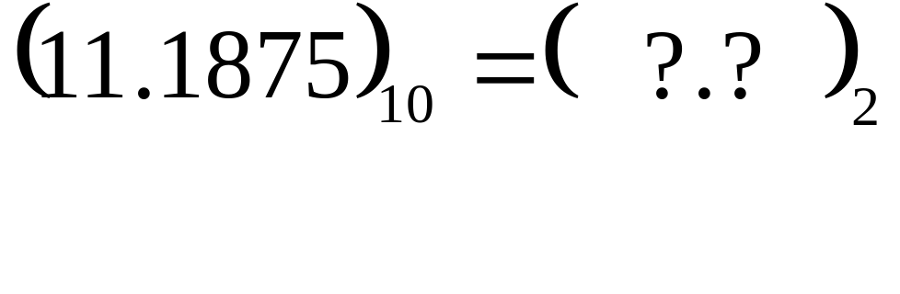
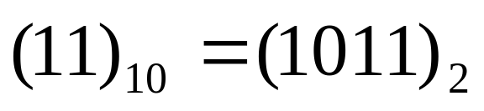
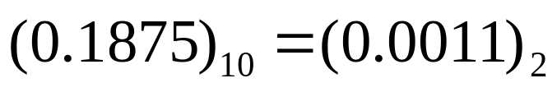
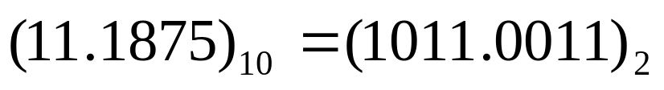
Decimal Number to Binary
Since
and
we have

Slide 96









All Fractional Decimal Numbers Cannot be Represented Exactly
Table 3. Converting a base-10 fraction to approximate binary representation.
 | Number | Number after decimal | Number before Decimal
 | 0.6 | 0.6
 | 1.2 | 0.2
 | 0.4 | 0.4
 | 0.8 | 0.8
 | 1.6 | 0.6

Slide 97
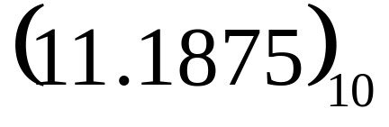
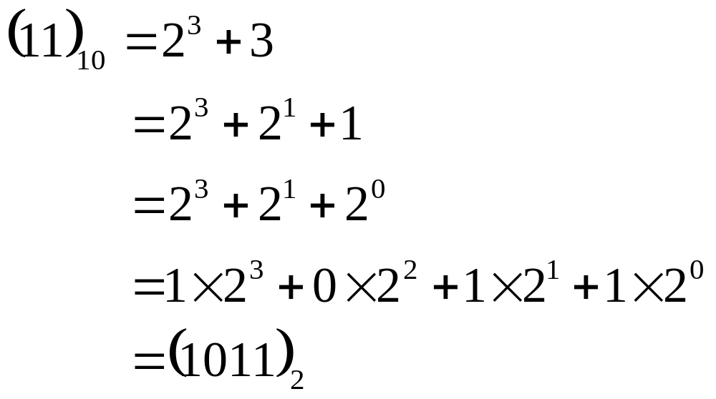
Another Way to Look at Conversion
Convert to base 2

Slide 98
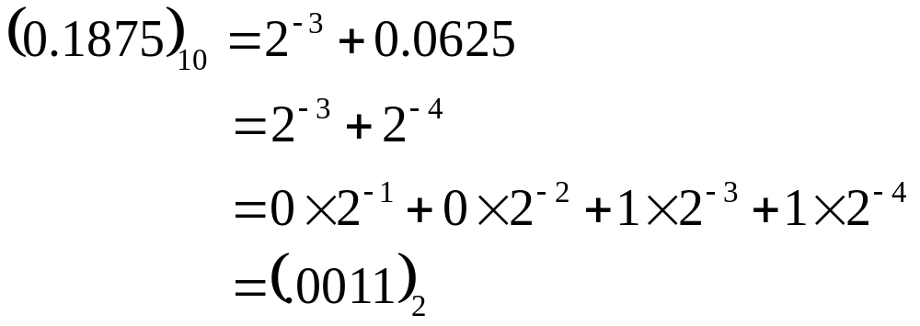


Slide 99
Floating Point Representation

Slide 100

Floating Decimal Point : Scientific Form

Slide 101




Example
The form is
or
Example: For

Slide 102


Floating Point Format for Binary Numbers
1 is not stored as it is always given to be 1.

Slide 103
Propagation of Errors

Slide 104
Propagation of Errors
In numerical methods, the calculations are not made with exact numbers. How do these inaccuracies propagate through the calculations?

Slide 105
Example 1:
Find the bounds for the propagation in adding two numbers. For example if one is calculating X +Y where
X = 1.5 ± 0.05
Y = 3.4 ± 0.04
Solution
Maximum possible value of X = 1.55 and Y = 3.44
Maximum possible value of X + Y = 1.55 + 3.44 = 4.99
Minimum possible value of X = 1.45 and Y = 3.36.
Minimum possible value of X + Y = 1.45 + 3.36 = 4.81
Hence
4.81 ≤ X + Y ≤4.99.

Slide 106



Propagation of Errors In Formulas
If
is a function of several variables
then the maximum possible value of the error in is

Slide 107




Example 2:
The strain in an axial member of a square cross-section is given by
Given
Find the maximum possible error in the measured strain.

Slide 108




Example 2:
Solution
Notes:
THG picture

Slide 109







Example 2:
Thus
Hence
Notes:
THG picture

Slide 110





Example 3:
Subtraction of numbers that are nearly equal can create unwanted inaccuracies. Using the formula for error propagation, show that this is true.
Solution
Let
Then
So the relative change is

Slide 111



Example 3:
For example if
= 0.6667
= 66.67%

Slide 112
Taylor Series Revisited

Slide 113



What is a Taylor series?
Some examples of Taylor series which you must have seen

Slide 114

General Taylor Series
The general form of the Taylor series is given by
provided that all derivatives of f(x) are continuous and exist in the interval [x,x+h]
What does this mean in plain English?
As Archimedes would have said, “Give me the value of the function at a single point, and the value of all (first, second, and so on) its derivatives at that single point, and I can give you the value of the function at any other point” (fine print excluded)

Slide 115









Example—Taylor Series
Find the value of
given that
and all other higher order derivatives
of
at
are zero.
Solution:

Slide 116




Example (cont.)
Solution: (cont.)
Since the higher order derivatives are zero,
Note that to find
exactly, we only need the value
of the function and all its derivatives at some other point, in this case

Slide 117
Derivation for Maclaurin Series for e^{x}
Derive the Maclaurin series
The Maclaurin series is simply the Taylor series about the point x=0

Slide 118




Derivation (cont.)
Since
and
the Maclaurin series is then
So,

Slide 119



Error in Taylor Series
The Taylor polynomial of order n of a function f(x) with (n+1) continuous derivatives in the domain [x,x+h] is given by
where the remainder is given by
where
that is, c is some point in the domain [x,x+h]

Slide 120



Example—error in Taylor series
The Taylor series for
at point
is given by
It can be seen that as the number of terms used
increases, the error bound decreases and hence a
better estimate of the function can be found.
How many terms would it require to get an approximation of e¹ within a magnitude of true error of less than 10^{-6.}

Slide 121








Example—(cont.)
Solution:
Using
terms of Taylor series gives error
bound of
Since

Slide 122






Example—(cont.)
Solution: (cont.)
So if we want to find out how many terms it would
require to get an approximation of
within a
,
magnitude of true error of less than
So 9 terms or more are needed to get a true error
less than

